Slide 1

LIFESTYLE AND ALZHEIMER’S PREDICTING ONSET THROUGH BEHAVIORAL ANALYSIS
Hadassah Olive Chinnam
Nithya Satya Meka
Shashank Raj Mysolla
Sravani Pendyala
Srija Velumula

Slide 2



TABLE OF CONTENTS
1. Data Description
2. Data Attributes
3.Data Visualization
4.Regression
5. Model Analysis – KNN & NB
6. SVM Model Analysis
7.Random Forest
8. Conclusion
9. References
10. Contributions

Slide 3

DATA DESCRIPTION
https://www.kaggle.com/datasets/rabieelkharoua/alzheimers-disease-dataset/data
The dataset comprises health records for 2,149 patients, including those diagnosed with or are at risk for Alzheimer's disease. The dataset contains detailed information on demographic characteristics, lifestyle habits, medical history, clinical measurements, cognitive and functional assessments, symptoms, and diagnostic information which allows for an in-depth evaluation of Alzheimer's disease, by examining how various demographic, lifestyle, medical, and cognitive factors are interconnected and impact both diagnosis and disease progression.

Slide 4

DATA ATTRIBUTES
Demographic details include age, gender, ethnicity, and education background
Lifestyle factors include BMI, smoking status, alcohol consumption, physical activity, diet quality, and sleep quality provide information on how these daily habits may affect cognitive health.
Medical history include factors such as cardiovascular disease, diabetes, depression, head injury, hypertension, and family history of Alzheimer’s were collected to determine their impact on Alzheimer’s risk.
Clinical parameters include measurement of systolic and diastolic blood pressure along with the cholesterol levels.

Slide 5
DATA ATTRIBUTES
Assessments of Cognitive and Functional abilities are obtained by measuring the scores of MMSE, functional assessment, memory complaints, behavioral problems, and ADL scores.
Common Alzheimer’s symptoms include confusion, disorientation, personality changes, difficulty completing tasks, forgetfulness were recorded.
Diagnosis Information indicates whether each patient has been diagnosed with Alzheimer's disease, allowing for the analysis of various factors associated with the diagnosis.

Slide 6
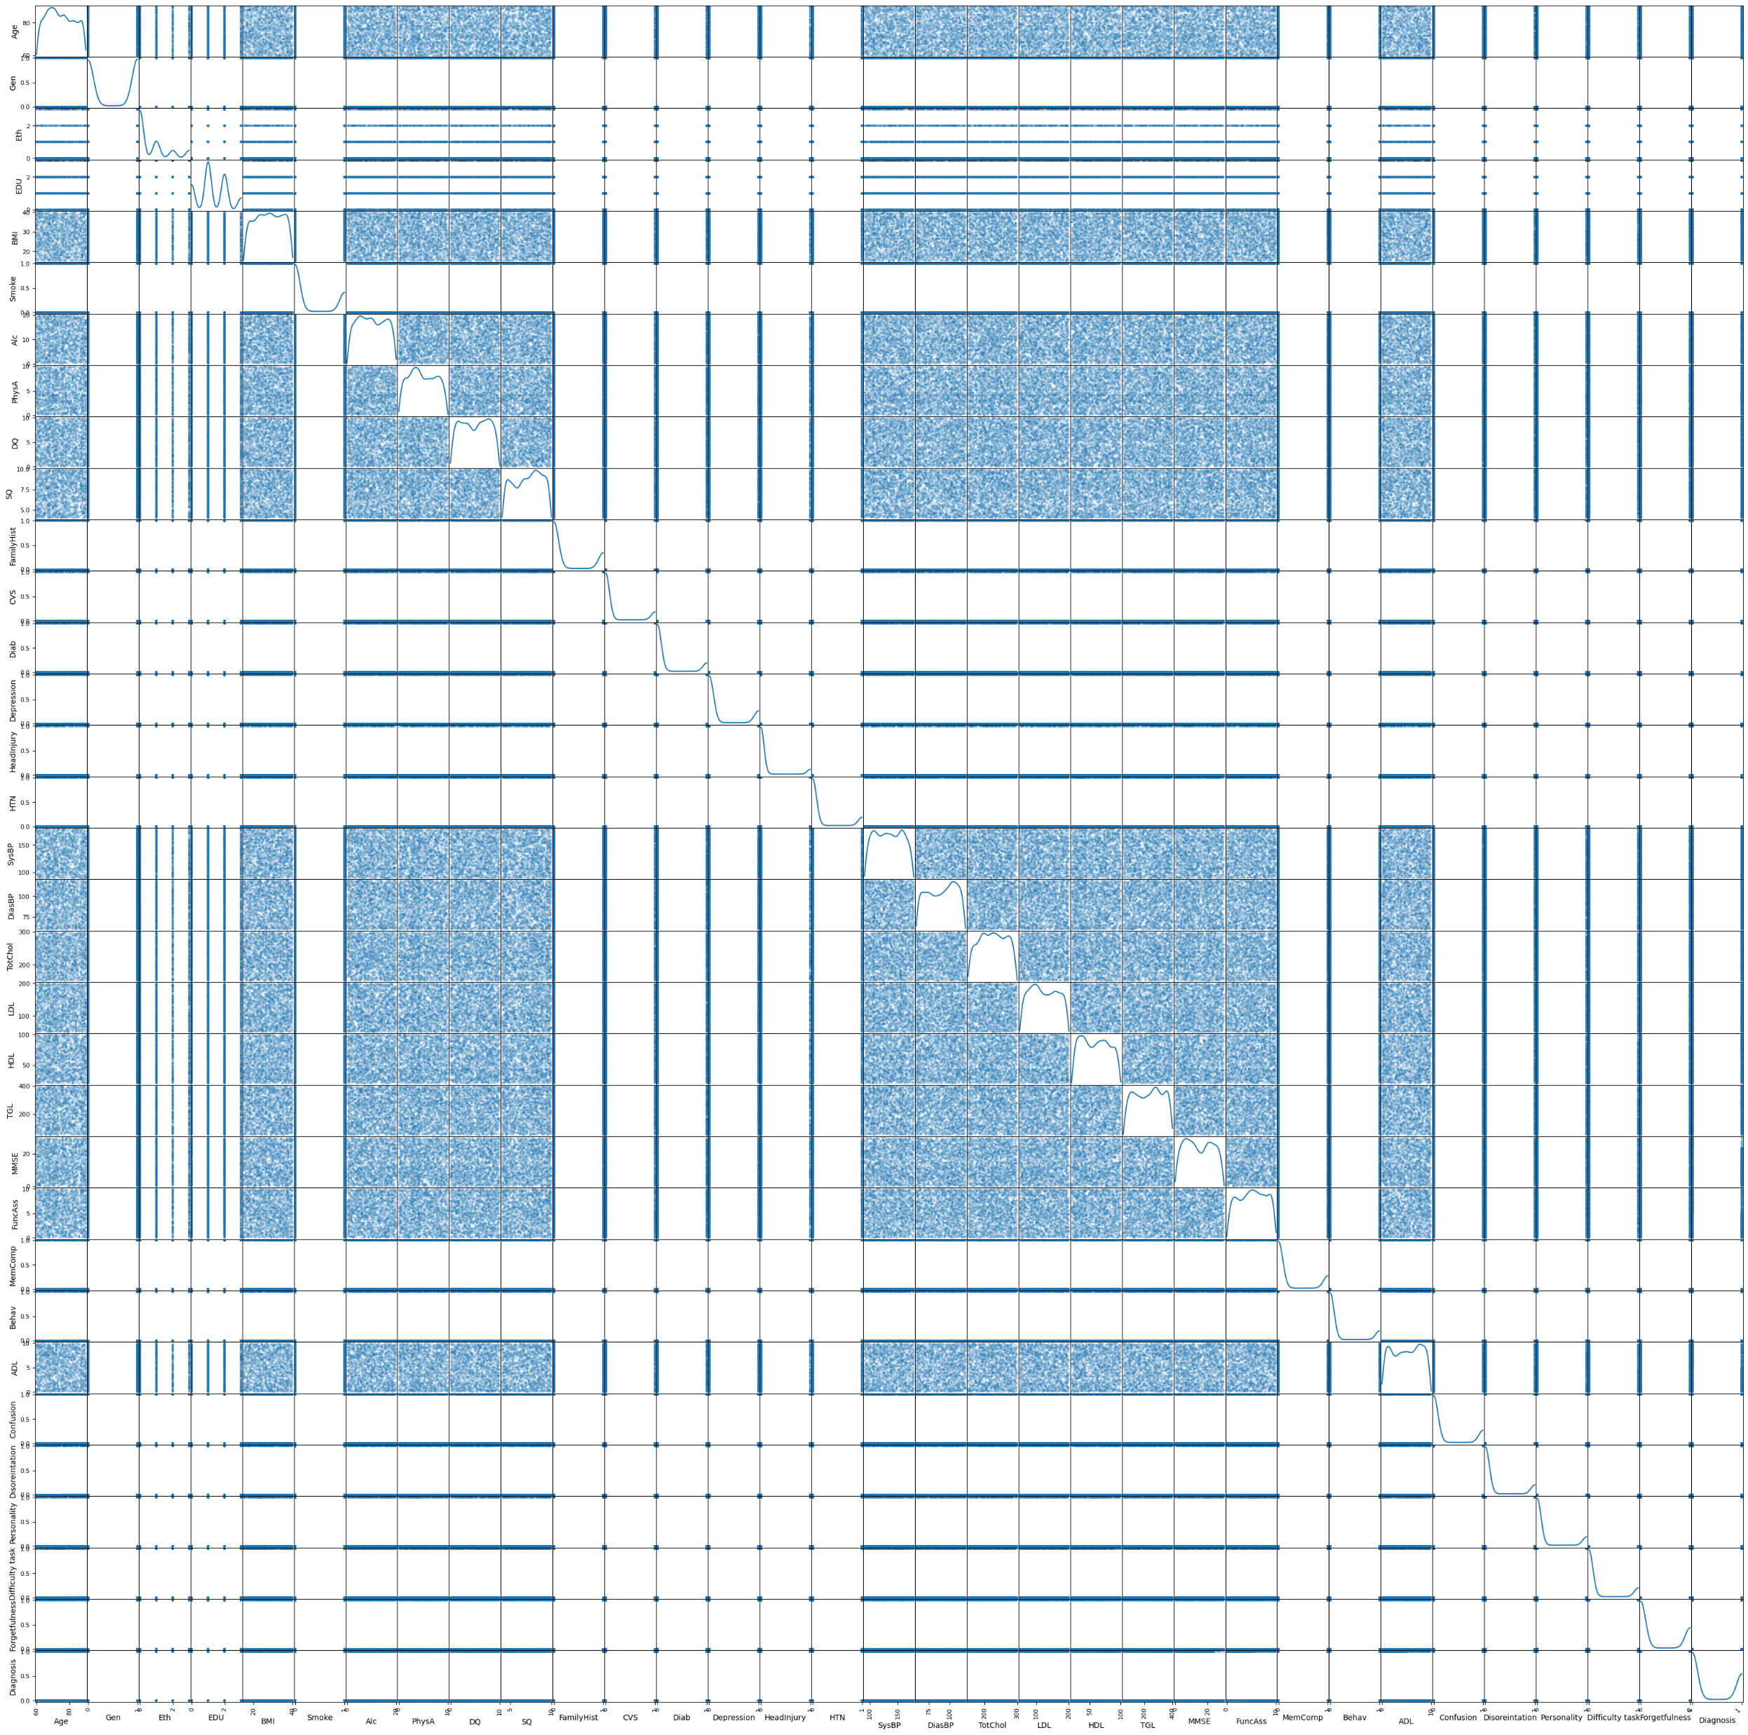
Data Visualization Scatter Plot
Interpretation:
From the scatter plot, it can be noted there was no clear correlation pattern observed, hence a heatmap was plotted to observe the correlation of the features.

Slide 7
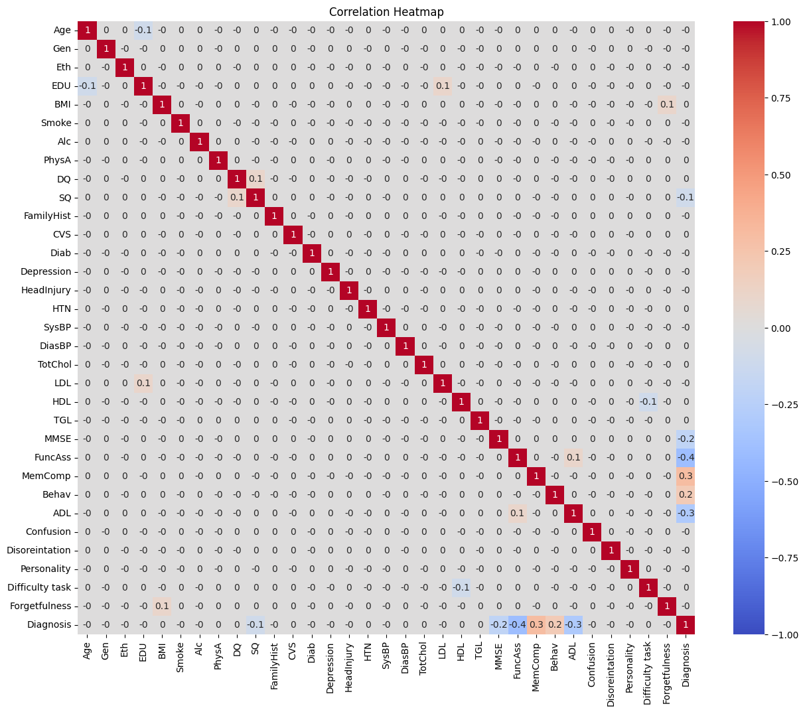
Heat Map

Slide 8

Data Visualization- Heat Map
From the heat map, it was observed that the following features tend to be correlated:
Positive Correlation:
A positive correlation of 0.3 between memory complaints and diagnosis was noticed that as memory complaints increase, the likelihood of a positive diagnosis (possibly for a cognitive condition) also rises. Similarly, a 0.2 correlation between behavioral problems and diagnosis indicated a mild relationship, where behavioral issues are slightly linked with diagnostic outcomes.
In addition, other features such as education level and Cholesterol LDL as well as BMI and forgetfulness both have low positive correlations of 0.1, suggesting a minimal or negligible influence.
Functional assessment and Activities of Daily Living (ADL) score show small positive association, possibly indicating that daily functioning abilities correspond, to some extent, with cognitive measures.

Slide 9
Data Visualization- Heat Map
Negative Correlation:
A negative correlation of -0.4 between functional assessment and diagnosis, and -0.3 between ADL score and diagnosis, were observed suggesting that worse functioning in these areas is associated with a higher likelihood of a cognitive diagnosis.
The Mini-Mental State Examination (MMSE) score also showed a negative correlation of -0.2 with diagnosis, implying that lower cognitive test scores are associated with more severe diagnoses.
Smaller negative correlations, such as -0.1 between Cholesterol HDL and task difficulty, education level and age, and Sleep Quality & diagnosis, indicate a subtle inverse relationships that could contribute to overall health and cognitive outcomes.
Overall, these findings highlight both cognitive and physical factors that may influence or signal cognitive decline or related diagnoses.

Slide 10
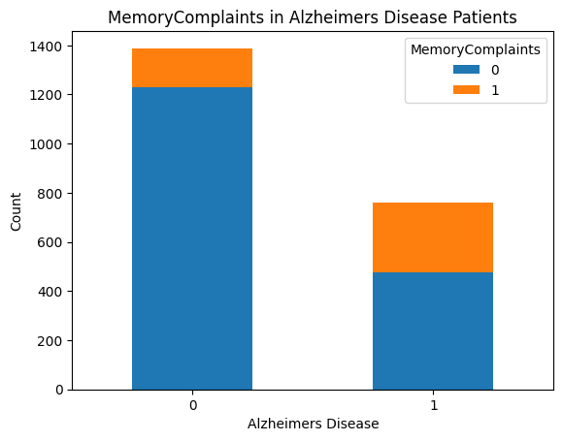
Data Visualization- Bar Plot
Interpretation:
From the bar plot, it can be observed that memory complaints were more frequent among Alzheimer's patients, though a significant number of them did not report memory complaints. In the non-Alzheimer’s group, most individuals do not report memory complaints, but a notable portion still does. This suggests that memory complaints are not limited to Alzheimer’s disease and may occur for other reasons.

Slide 11
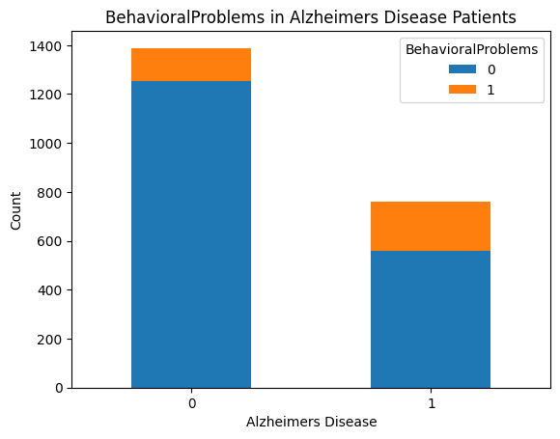
Data Visualization- Bar Plot
Interpretation:
From the graph, it can be noticed that the most of non-Alzheimer's patients did not experience behavioral problems, with a smaller percentage having these problems. In contrast, while the total number of Alzheimer's patients was lower, a greater proportion of them experienced behavioral issues compared to the non-Alzheimer's patients. This suggests a potential association between Alzheimer's disease and an increased likelihood of behavioral problems.

Slide 12
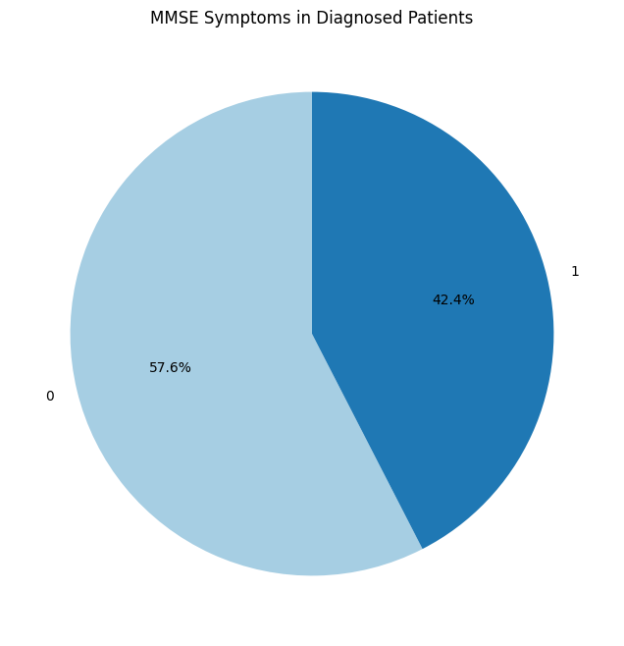
Data Visualization- Pie Chart
Interpretation:
From the pie chart, it can be seen that more than half of the percentage of individuals who were not diagnosed with Alzheimer’s disease has presented MMSE symptoms when compared to the people who were diagnosed with Alzheimer’s.

Slide 13
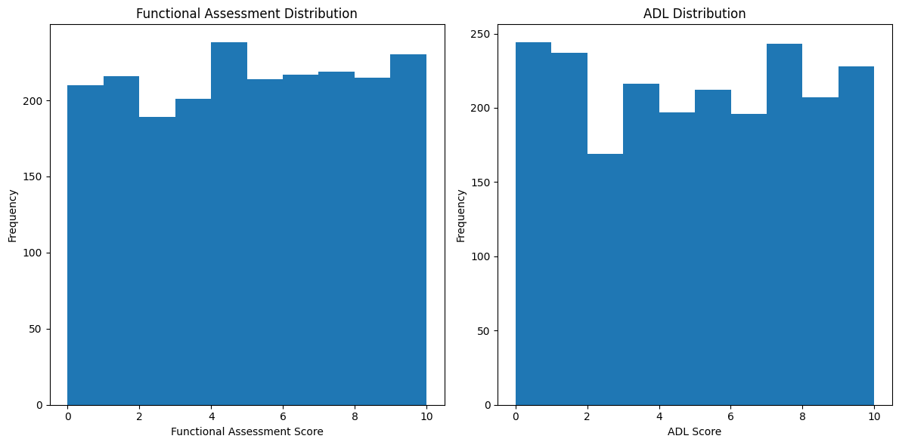
Data Visualization- Histogram
Interpretation:
The Functional Assessment scores were relatively evenly distributed, with no significant concentration in one area. The ADL scores also show a broad distribution, but there were noticeable dips in the frequency of certain scores. Overall, both assessments show variation across the population, highlighting differing levels of impairment.

Slide 14
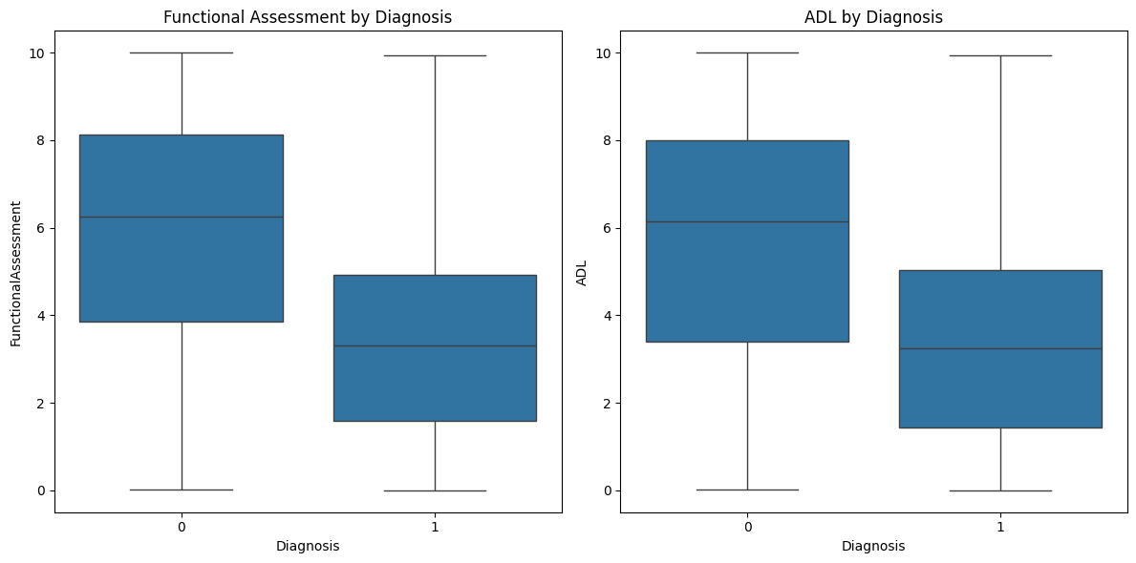
Data Visualization- Box Plot
Interpretation:
From the boxplots, it was observed that for cases where Alzheimer's diagnosis occurred have lesser values of Functional assessment values and lesser values of ADL, indicating that lesser values of these features are at more risk of Alzheimer's disease.

Slide 15
REGRESSION
Linear Regression: Since the outcome or target variable is binary in nature, the linear regression was not performed, and the linear regression equation was not calculated for this data. Hence, a Logistic regression model has been built for the prediction of Alzheimer's disease.

Slide 16
REGRESSION
Logistic Regression Model:
from sklearn.linear_model import LogisticRegression
from sklearn.metrics import classification_report, confusion_matrix
x=df_alzr[['MMSE', 'MemComp', 'Behav']]
y=df_alzr['Diagnosis']
model = LogisticRegression(solver='liblinear',C=10,random_state=0) # define model
model.fit(x,y)
# evaluate the model
p_pred=model.predict_proba(x)
y_pred=model.predict(x)
scor=model.score(x,y)
conf_m=confusion_matrix(y,y_pred)
print(scor)
print(conf_m)

Slide 17
REGRESSION
Output/Results:
0.7566309911586785
[[1262 127] [ 396 364]]
Interpretation:
From the results, it can be observed that the model correctly predicted the Alzheimer’s diagnosis of about 75.6%. The confusion matrix results reveal that the model correctly predicted the positive class 364 times and 1262 times the negative class. In addition, the model incorrectly predicted the false positive and false negative 127 and 396 times respectively.

Slide 18
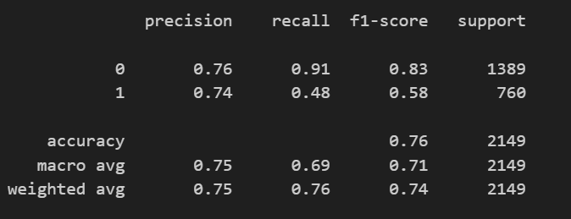
REGRESSION
The logistic regression model was evaluated using a classification report, which provided detailed metrics for each class (0 = Non-Alzheimer's, 1 = Alzheimer's) based on the predicted and actual labels.
# Model Evaluation
print(classification_report(y,model.predict(x)))

Slide 19
REGRESSION
Interpretation:
Based on the results, the model's precision for class 0 (no diagnosis) is 76% and for class 1 (diagnosis) is 74%. The model identified 91% of the true negative class (class 0), whereas it has identified only 47% of the true positive cases (class 1). The F1 scores show that the model did great in predicting the patients who were not diagnosed with Alzheimer’s than with the people with actual diagnosis (i.e., 83% and 58% respectively). Overall, the model performed well in predicting the negative class with high recall (91%) and a good F1-score (83%). However, the performance for the positive class was low, indicating that it has missed a significant number of the diagnosed cases.

Slide 20
K Nearest Neighbor (KNN) Model
# KNN Graph
x = df_alzr[['MMSE', 'MemComp']]
y = df_alzr['Diagnosis’]
import numpy as np
from sklearn.neighbors import
KNeighborsClassifier
import matplotlib.pyplot as plt
SSE=[]
for k in range(1,20):
knn=KNeighborsClassifier(n_neighbors=k)
knn.fit(x,y)
pred_i=knn.predict(x)
SSE.append(np.mean(pred_i != y))
plt.figure(figsize=(20,10))
plt.plot(range(1,20),SSE,color='b',linestyle='dashed',marker='o',markerfacecolor='r',markersize=10)
plt.show()

Slide 21
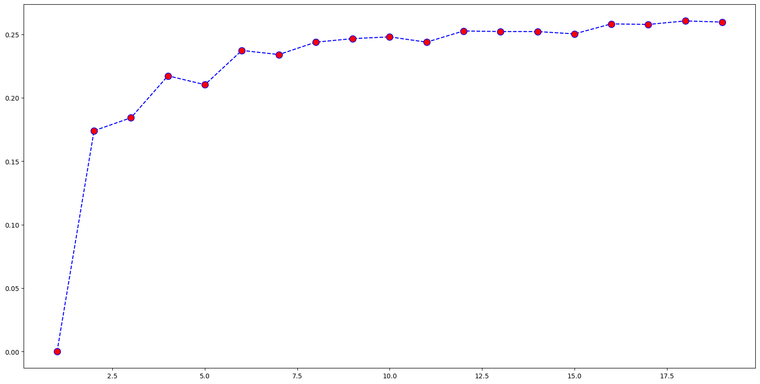
K Nearest Neighbor (KNN) Model
Interpretation:
From the elbow graph, the best k- value was found to be ‘3’, suggesting that the best number of clusters occurs at that point.

Slide 22
K Nearest Neighbor (KNN) Model
from sklearn.model_selection import train_test_split
X_train, X_test, y_train, y_test = train_test_split(X, y, test_size = 0.2) train_accuracy = clf.score(X_train, y_train)
test_accuracy = clf.score(X_test, y_test)
print(train_accuracy)
print(test_accuracy)
Results: 0.8103548574752764
0.8372093023255814
Interpretation:
From the results, it can be observed that KNN model shows high accuracy values for both training and testing data (about 81% and 83% respectively), suggesting that the model performs well for both training and testing data. However, the accuracy for testing data is slightly higher than the training indicating that the it has better performance on the test data. This shows that the model does not overfit and performs well for the new unseen data with good predictive power.

Slide 23
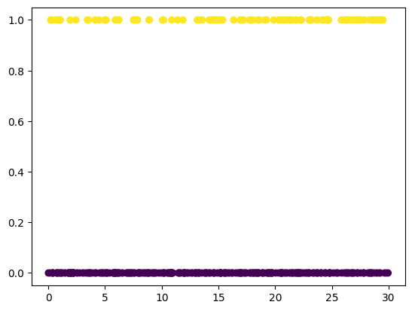
Gaussian Naive Bayesian Model
from sklearn.naive_bayes import GaussianNB
from sklearn.model_selection import train_test_split
X_train, X_test, y_train, y_test=train_test_split(X,y,test_size=0.2, random_state=0)
clf=GaussianNB()
clf.fit(X_train,y_train)
y_pred=clf.predict(X_test)
plt.scatter(X_test[:,0],X_test[:,1], c=y_pred, cmap='viridis')
plt.show()
Interpretation:
The scatter plot shows the classification results of the Naive Bayes model, the clusters indicate that the model has separated the data successfully, suggesting that the model has performed well in distinguishing between the two classes.

Slide 24
Gaussian Naive Bayesian Model
train_accuracy = clf.score(X_train, y_train)
test_accuracy = clf.score(X_test, y_test)
print(train_accuracy)
print(test_accuracy)
Results: 0.7079697498545666
0.6906976744186046
Interpretation:
Similar to the KNN model, the Bayesian model shows high training accuracy(around 70%) and a slightly lower accuracy for the testing data (about 69%). However, the values indicate that the model performs well and was not overfitting for the dataset.
To conclude, the KNN model seems to perform well for predicting diagnosis of Alzheimer’s disease than the Bayesian model, with higher accuracy values of both training and testing data based on the features (memory complaints and MMSE (mini-mental state examination)).

Slide 25
Support Vector Machine (SVM) Model
Selecting training features and target
x = df_alzr[['MMSE', 'MemComp']]
y = df_alzr['Diagnosis’]
Results:
svc accuracy 70.45137273150303
linear svc accuracy 73.05723592368544
rbf accuracy 73.98790134946486
poly accuracy 64.63471382038158

Slide 26
Support Vector Machine (SVM) Model
# define- fit - predict - find the accuracy of models
from sklearn import svm
from sklearn.metrics import accuracy_score
# linear kernel
svc=svm.SVC(kernel='linear', C=1).fit(x,y)
svc_pred=svc.predict(x)
print('svc accuracy',accuracy_score(y,svc_pred)*100)
# linear svm
lin_svc=svm.LinearSVC(C=1).fit(x,y)
lsvc_pred=lin_svc.predict(x)
print('linear svc accuracy',accuracy_score(y,lsvc_pred)*100)
# rbf kernel
rbf_svc=svm.SVC(kernel='rbf', gamma=0.7, C=1).fit(x,y)
rsvc_pred=rbf_svc.predict(x)
print('rbf accuracy',accuracy_score(y,rsvc_pred)*100)
# poly kernel, degree 3 ax^3+bx^2+cx+d
poly_svc=svm.SVC(kernel='poly', degree=3, C=1).fit(x,y)
psvc_pred=poly_svc.predict(x)
print('poly accuracy',accuracy_score(y,psvc_pred)*100)

Slide 27
Support Vector Machine (SVM) Model
Interpretation:
Out of 4 models, it can be observed that the RBF SVC model has the highest accuracy value 73.98%, suggesting that it effectively interpreted non-linear relationships in the data. The linear SVC model also performed well, with an accuracy of 73.05%, indicating that a linear decision boundary was quite effective. The Polynomial SVC model had the lowest accuracy at 64.63%, while the default SVC model had the highest accuracy at 70.45%. In this dataset, the RBF SVC model seem to predict Alzheimer's disease diagnoses the best overall.

Slide 28
Support Vector Machine (SVM) Model
h=0.02
x_min, x_max = x[:,0].min()-1, x[:,0].max()+1 # MMSE over x axis
y_min, y_max = x[:,1].min()-1, x[:,1].max()+1 # Memory complaints over y axis
xx, yy=np.meshgrid(np.arange(x_min,x_max,h),np.arange(y_min,y_max,h))
titles=['sigmoid','linear svc','rbf','poly']
for i, clf in enumerate((svc, lin_svc, rbf_svc, poly_svc)):
# create 4 subplots
plt.subplot(2,2,i+1)
plt.subplots_adjust(wspace=0.4,hspace=0.4)
# predict destinations based on num_code and price
Z=clf.predict(np.c_[xx.ravel(),yy.ravel()])
Z=Z.reshape(xx.shape)
# plot actual and predicted values
plt.contourf(xx,yy,Z,cmap=plt.cm.coolwarm, alpha=0.8)
plt.scatter(x[:,0],x[:,1], c=y, cmap=plt.cm.coolwarm)

Slide 29
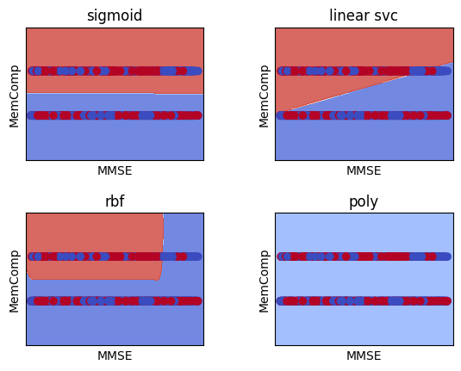
Support Vector Machine (SVM) Model
# modify the graphs by adding labels, titles,
plt.xlabel('MMSE')
plt.ylabel('MemComp')
plt.xlim(xx.min(),xx.max())
plt.ylim(yy.min(),yy.max())
plt.xticks(())
plt.yticks(())
plt.title(titles[i])
plt.show()

Slide 30
Support Vector Machine (SVM) Model
The sigmoid kernel produced a weak, overlapping boundary, indicating it struggles with the data's structure.
The linear SVC displayed a straight boundary, capturing class separation reasonably well but lacking flexibility in regions with overlapping classes.
The RBF kernel created a non-linear boundary, adapting to the data’s complexity effectively, resulting in clearer separation.
The polynomial kernel also forms a non-linear boundary but is less flexible than RBF, leading to some misclassifications.
Overall, for this dataset, the RBF kernel works best because it can adjust to the complexity of the data and offers more distinct class separation, whereas the sigmoid kernel has trouble with the structure of the data.

Slide 31
Random Forest
Code:
x = df_alzr[['MMSE', 'MemComp']] .to_numpy()
y = df_alzr['Diagnosis’]
# split data to train and test
X_train, X_test, y_train, y_test=train_test_split(X,y, test_size=0.3)
# define the model, fit the model
clf=RandomForestClassifier(n_estimators=50)
clf.fit(X_train, y_train)
RandomForestClassifier(n_estimators=50)
y_pred=clf.predict(X_test)
from sklearn.metrics import confusion_matrix, accuracy_score, classification_report
CM=confusion_matrix(y_pred,y_test)
AS=accuracy_score(y_pred,y_test)
CR=classification_report(y_pred,y_test)
print(CM) print(AS) print(CR)

Slide 32
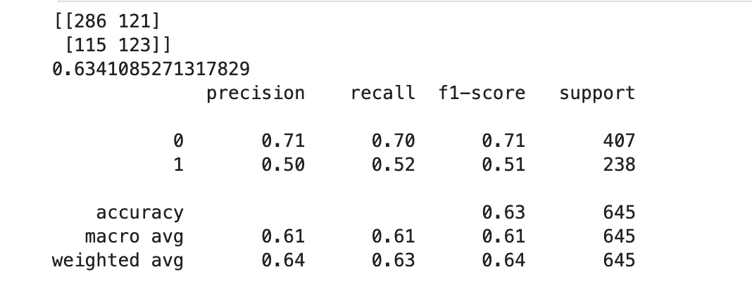
Random Forest
Results:
The confusion matrix reveals that the model correctly identified 286 true positives and 123 true negatives while misclassifying 121 instances as false positives and 115 as false negatives.
The model achieves an overall accuracy of 63.41%, indicating it correctly predicts the target variable roughly two-thirds of the time.

Slide 33
Random Forest
Results:
The precision for Class 0 (negative diagnosis) is 71%, with a recall of 70%, resulting in an F1-score of 0.71. This indicates that the model is relatively effective at identifying negatives. However, for Class 1 (positive diagnosis), the precision and recall are both lower, around 50%, leading to an F1-score of 0.51. The disparity suggests that the model struggles with identifying true positives.
Out of 645 instances in the test dataset, the model correctly predicted 63% of all instances, indicating moderate overall performance. The Macro Average(61%) reflects the unweighted average of precision, recall, and F1-score across classes, showing balanced performance for each class regardless of size. Weighted Average (nearly 64%) accounts for class distribution, slightly favoring the larger class (class 0) due to its higher representation.

Slide 34
Random Forest
Code:
!conda info --envs
%pip install graphviz
from sklearn.tree import export_graphviz
import graphviz
# Make a Random Forest rf=RandomForestClassifier(n_estimators=1)
rf.fit(X_train,y_train)
len(rf.estimators_)
Results:
1
This confirms that the Random Forest contains only 1 decision tree

Slide 35
Random Forest
Code:
from sklearn import tree
x = df_alzr[['MMSE', 'MemComp']].to_numpy()
y = df_alzr['Diagnosis’]
plt.figure(figsize=(20,20))
_=tree.plot_tree(rf.estimators_[0], filled=True)

Slide 36
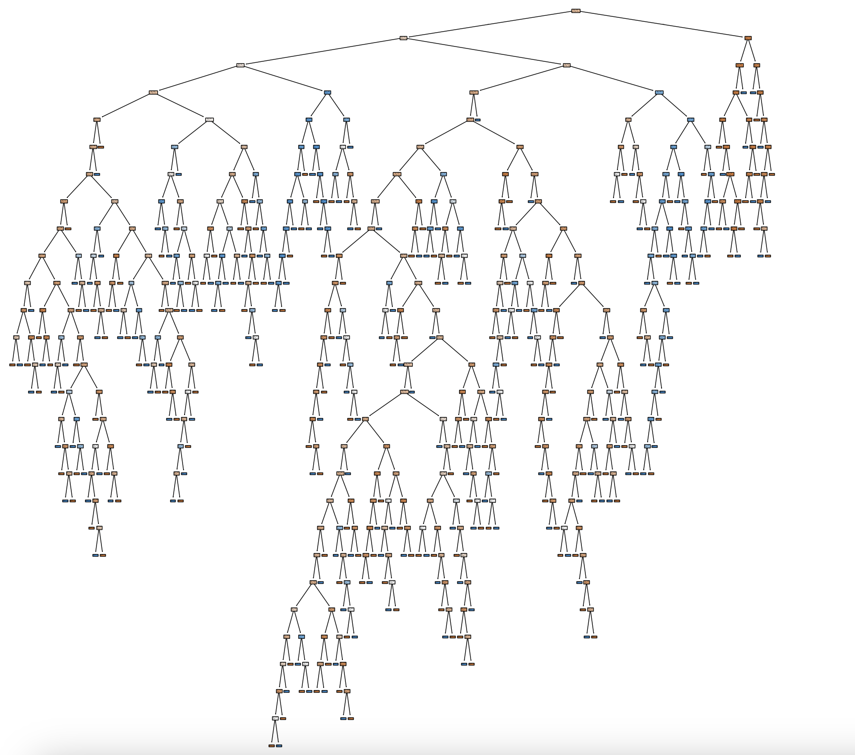
Random Forest
Results:
The tree plot is highly complex and deeply branched, reflecting the complicated nature and size of the data. However, the extensive branching makes interpreting or extracting meaningful insights challenging.

Slide 37
Conclusion
The analysis of the Alzheimer's disease dataset highlights the significant interplay between lifestyle factors and the onset of Alzheimer's, emphasizing the importance of behavioral analysis in predicting cognitive decline. The findings indicate that the features like memory complaints, MMSE scores and behavioral symptoms played a significant role in predicting the Alzheimer’s disease.
In addition, the strong negative correlation between cognitive and functional assessments with the diagnosis, indicate that these tests were useful for early detection. This suggests that poorer cognitive and functional health is indicative of a higher risk for Alzheimer's disease. Furthermore, the bar plots and pie charts illustrated that memory complaints and behavioral problems were more prevalent among Alzheimer's patients, reinforcing the notion that these symptoms are critical indicators of the disease.

Slide 38
Conclusion
The K-Nearest Neighbors (KNN) model achieved the highest testing accuracy of 83.7%. This implies that it balances predictive performance across training and testing data without overfitting. While, the Random Forest model performed poorly, with an overall accuracy of 63.4%, indicating that it is ineffective and has high misclassification rates for diagnosing Alzheimer’s.
Overall, the findings from this analysis advocate for a holistic approach to Alzheimer's research, where lifestyle and behavioral factors are recognized as vital components in understanding, predicting, and potentially mitigating the onset of this debilitating disease. Future research should continue to explore these relationships, aiming to develop comprehensive frameworks that incorporate lifestyle modifications as part of Alzheimer's prevention and management strategies.

Slide 39
References
Behavioural symptoms in patients with Alzheimer's disease and their association with cognitive impairment. Fernandez, M., Gobartt, A. L., & Balana, M. (2010). Behavioural symptoms in patients with Alzheimer’s disease and their association with cognitive impairment. BMC Neurology, 10(1). Retrieved from: https://doi.org/10.1186/1471-2377-10-87
A Predictive and Preventive Model for Onset of Alzheimer's Disease. Singhania, Udit; Tripathy, Balakrushna; Hasan, Mohammad Kamrul; Anumbe, Noble C.; Alboaneen, Dabiah; Ahmed, Fatima Rayan Awad; Ahmed, Thowiba E.; Nour, Manasik M. Mohamed. Retrieved from: https://doi.org/10.3389/fpubh.2021.751536
Linguistic markers predict onset of Alzheimer's disease. Eyigoz E, Mathur S, Santamaria M, Cecchi G, Naylor M. Linguistic markers predict onset of Alzheimer's disease. EClinicalMedicine. Retrieved from: https://doi.org/10.1016/j.eclinm.2020.100583

Slide 40
Contributions
Hadassah Olive Chinnam - Introduction, Dataset selection, Visualization, Conclusion, Reference
Nithya Satya Meka - Introduction, Dataset selection, Visualization, Regression Analysis, Srija Velumula - Introduction, Dataset selection, Regression Analysis, KNN & NB model analysis
Sravani Pendyala - Introduction, Dataset selection, KNN, NB, and SVM Analysis, Conclusion
Shashank Raj Mysolla - Dataset selection, SVM & Random Forest classifier analysis, and Conclusion

Slide 41

Thank You

